Slide 1
3 / 29 / 2011
Identifying and Obtaining Patents for SR&ED Practitioners
BENJAMIN MAK, Associate
B.A.Sc. (Eng.Sci), LL.B.

Slide 2
Introduction
In the News... (July 1, 2011)
Nortel Patent Auction $4.5 Billion
Nortel patent auction goes to Apple/Microsoft/RIM consortium (Divided amongst them)
Sold for $4.5 B (>6000 patents, approx. $750k each)
Initial bid of US$900 million from Google

Slide 3
Introduction
In the News... (August 15, 2011)
Google Buys Motorola Mobility For $12.5B
“Our acquisition of Motorola will increase competition by strengthening Google’s patent portfolio, which will enable us to better protect Android from anti-competitive threats from Microsoft, Apple and other companies.”
Posted by Larry Page, CEO Google

Slide 4
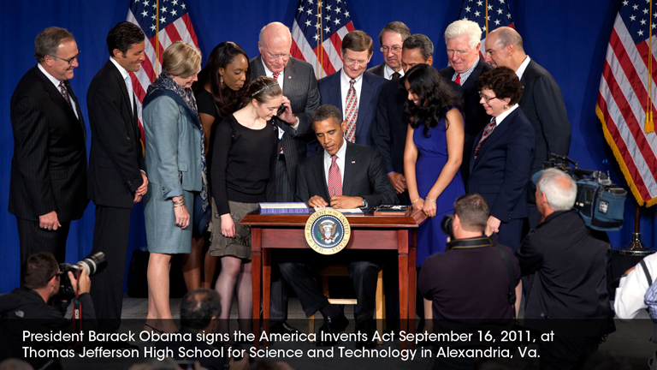
Introduction
In the News... (September 16, 2011)
Pres. Obama signs Leahy-Smith America Invents Act
15% increase in fees (immediately)
Eliminates most false marking lawsuits with exceptions
Post-grant review proceedings before the U.S. Patent and Trademark Office (after September 16, 2012)
Change to a first inventor to file system (after March 16, 2013)

Slide 5
Introduction
In the News...
Steve Jobs
(February 24, 1955 – October 5, 2011)
Steve Jobs, Apple, named as inventor on ~300 patents
Bill Gates, Microsoft (9 Patents)
Larry Page and Sergey Brin, Google (1-2 dozen patents)

Slide 6
Introduction
Patents
Copyright
Trademark
INTELLECTUAL PROPERTY
IC Topography
Design Patents
Trade Secrets
Trade Dress
Confidential Information

Slide 7
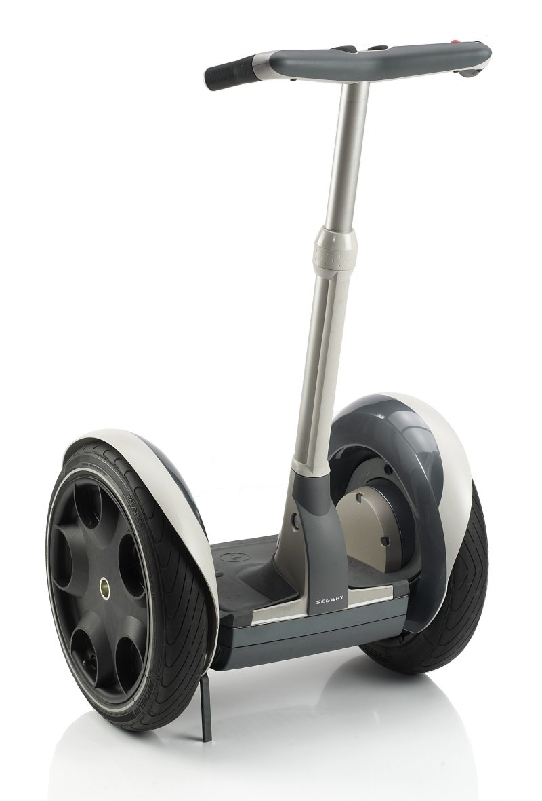
Introduction
Patents
Copyright
Trademark
INTELLECTUAL PROPERTY
IC Topography
Design Patents
Trade Secrets
Trade Dress
Confidential Information
E.g. SEGWAY®

Slide 8
Outline
1) Introduction to patents
2) Tools and Searching Methods
3) Identifying the invention
4) Examples and exercise

Slide 9
Outline
1) Introduction to patents
2) Tools and Searching Methods
3) Identifying the invention
4) Examples and exercise

Slide 10
1) Introduction to Patents
WHAT IS A PATENT?
An exclusive right to prevent others from making, selling or using an invention.
Patent term is 20 years from the filing date.
To promote investment in research and encourage sharing of information: “Patents fuel progress - Technologically sophisticated nations like Canada depend on the patent system for both scientific advancement and economic strength.” - Canadian Patent Office
Patent must be new and non-obvious
→ Keep your invention confidential until filing

Slide 11
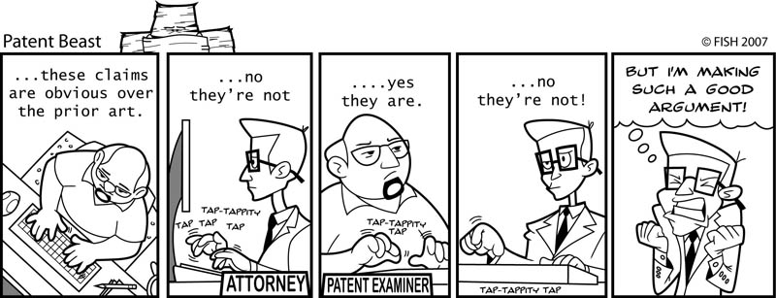
1) Introduction to Patents
WHAT IS A PATENT?
Patent must be non-obvious

Slide 12
1) Introduction to Patents
WHAT IS A PATENT?
SECRECY PERIOD
BENEFITS:
All patent applications gain the benefit of an 18 month secrecy period in the patent office
DISADVANTAGE:
This means that all patent databases are approximately 18 months out of date

Slide 13
1) Introduction to Patents
WHAT IS A PATENT?
The monopoly protected by a patent is defined by its CLAIMS

Slide 14
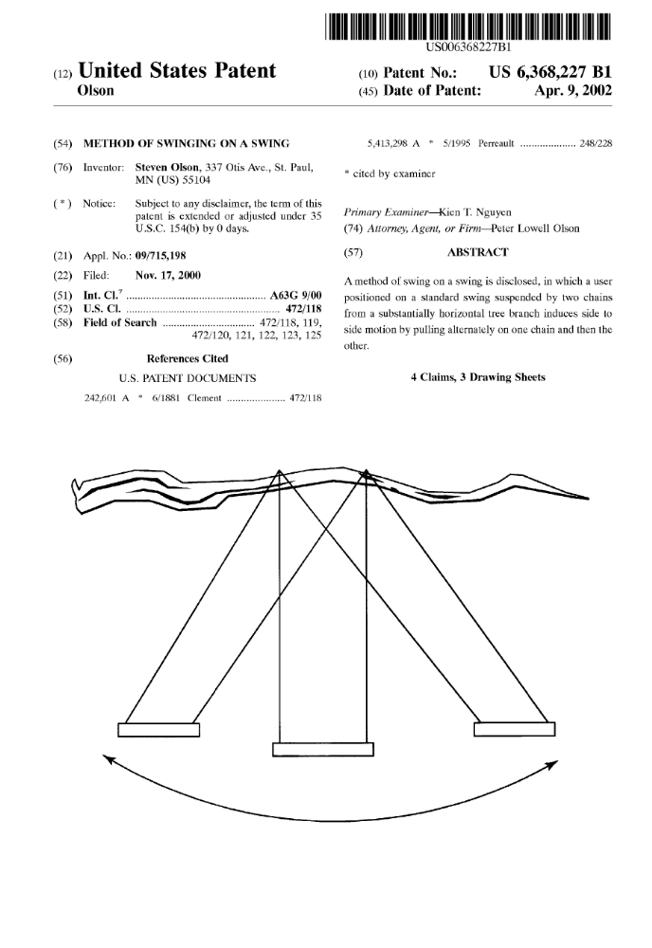
1) Introduction to Patents
WHAT IS A PATENT?

Slide 15
1) Introduction to Patents
WHAT IS A PATENT?
This is an issued patent!
Claim 1:
A method of swinging on a swing, the method comprising the steps of:
a) suspending a seat for supporting a user between only two chains that are hung from a tree branch;
b) positioning a user on the seat so that the user is facing a direction perpendicular to the tree branch;
c) having the user pull alternately on one chain to induce movement of the user and the swing toward one side, and then on the other chain to induce movement of the user and the swing toward the other side; and
d) repeating step c) to create side-to-side swinging motion, relative to the user, that is parallel to the tree branch.

Slide 16
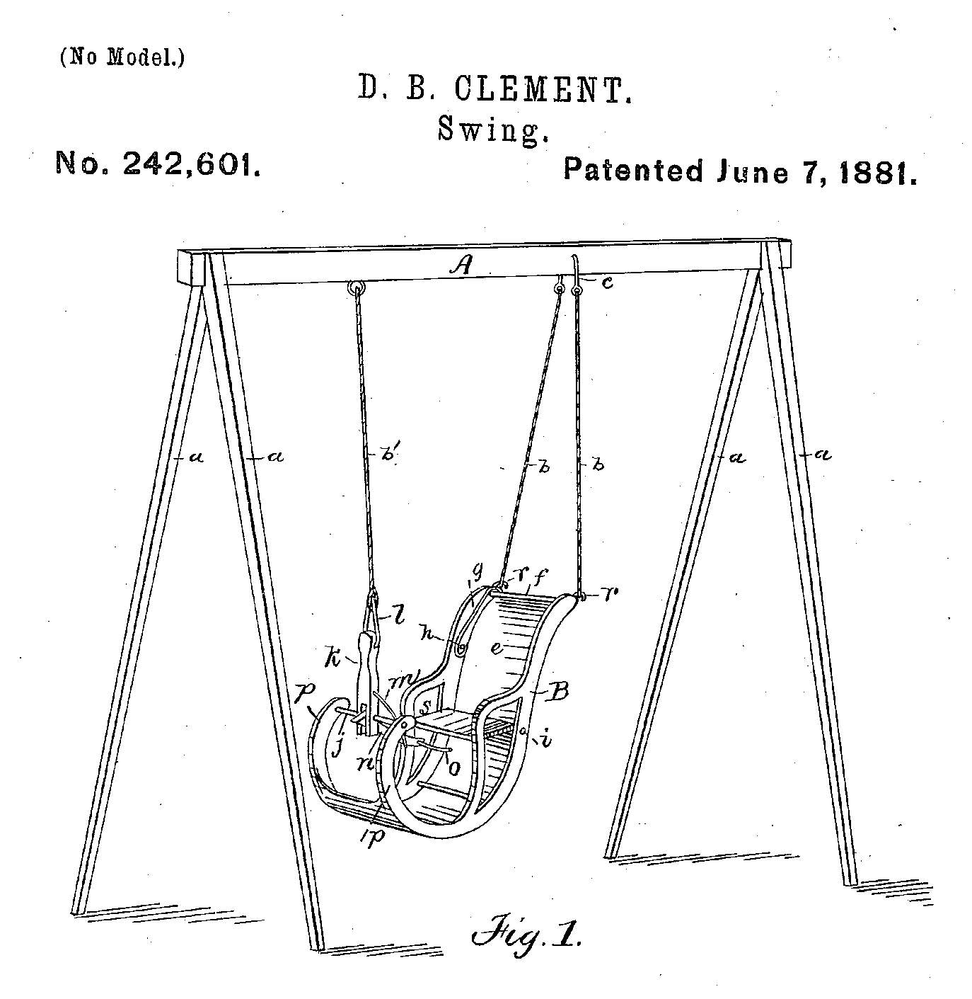
1) Introduction to Patents
WHAT IS A PATENT?
PRIOR ART 1
“Swing”

Slide 17
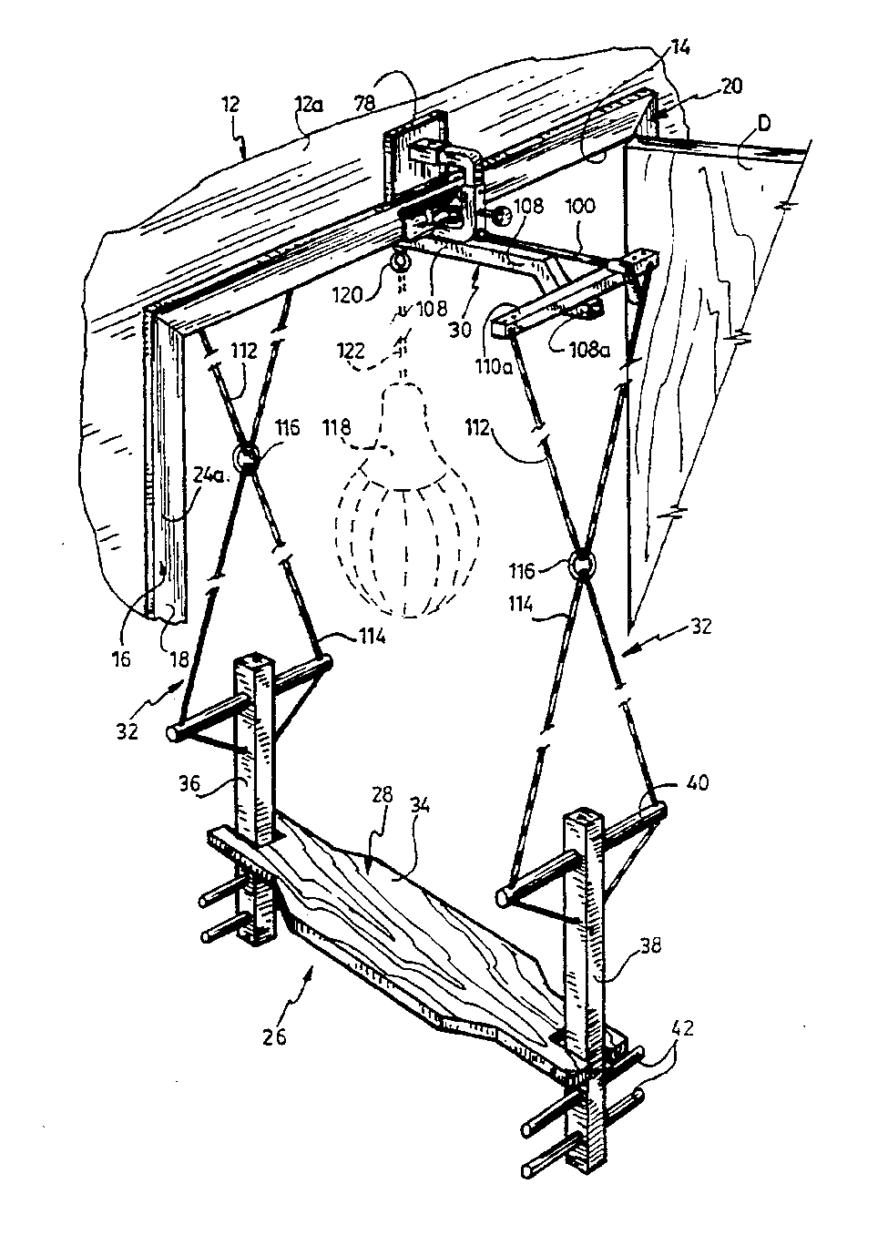
1) Introduction to Patents
WHAT IS A PATENT?
PRIOR ART 2
“Door Frame Mount for Swing”

Slide 18
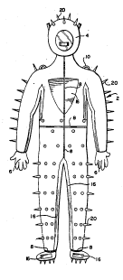
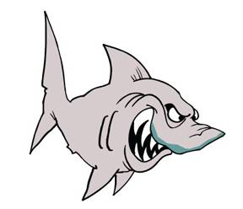
1) Introduction to Patents
WHAT IS A PATENT?
US Patent No. 4,833,729
“Shark Protector Suit”

Slide 19
1) Introduction to Patents
WHAT IS A PATENT?
US Patent No. 4,833,729
“Shark Protector Suit”
1. A suit for protecting its wearer from attack by sharks comprising:
rubber suit means for substantially completely covering the wearer's body;
closed helmet means including a face mask attached to the suit means for substantially completely covering the wearer's head;
glove means attached to the suit means for substantially completely covering the wearer's hands;
shoe means attached to the suit means for substantially completely covering the wearer's feet;
elongated spike means for repelling sharks extending outwardly from the suit means and helmet means; and rigid plate means attached to an outer surface of the suit for protecting the wearer.

Slide 20



1) Introduction to Patents
WHAT IS A PATENT?
Examples of Software Claims
1. A computer, comprising:
  a. a memory for storing a software application; and
  b. a processor for accessing the memory and for executing the software application, the processor configured for performing X and Y.
2. A computer readable memory having recorded thereon statements and instructions for execution by a computer, said statements and instructions comprising:
  a. code means for performing X; and
  b. code means for performing Y.
3. A computer-implemented method, comprising:

Slide 21
Outline
1) Introduction to patents
2) Tools and Searching Methods
3) Identifying the invention
4) Examples and exercise

Slide 22
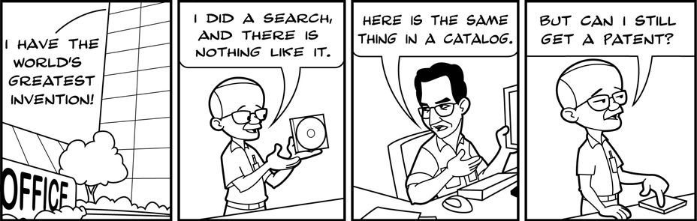
WHY SEARCH?
Patent must be new

Slide 23
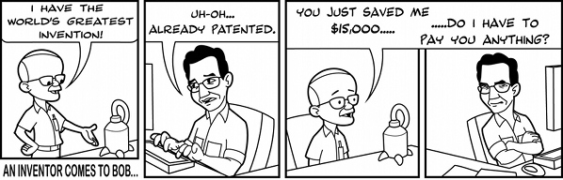
WHY SEARCH?
Save Money

Slide 24
2) Tools and Searching Methods
See handout
Patent Offices
Third Party Searching Tools
Patent Download Websites

Slide 25
2) Tools and Searching Methods
Patent Offices
Country | Website
Canada | http://strategis.ic.gc.ca/sc_mrksv/cipo/welcome/welcom-e.html
U.S. (*) | http://www.uspto.gov/patft/index.html
Europe (*) | http://ep.espacenet.com/?locale=EN_ep
Third Party Searching Tools
Name | Website
Google US patents (*) | http://www.google.com/patents
Delphion ($) | http://www.delphion.com/
Patent Download Websites
Name | Website
Google US patents | http://www.google.com/patents
Patent Fetcher (*) | http://sughrue.patentfetcher.com/
Pat2Pdf | http://www.pat2pdf.org/

Slide 26
2) Tools and Searching Methods
1) Patent Offices
Source websites for searching of a particular country or region’s Patent Office records
Advantages
- Database is based on the official Patent Office records
Disadvantages
- Limited to specific country (except Europe P.O.)
- Some search fields are limited or hard to use
- Basic search engine algorithms (boolean)
- Page-by-page downloading of patents is cumbersome
- US database separates patents from applications

Slide 27
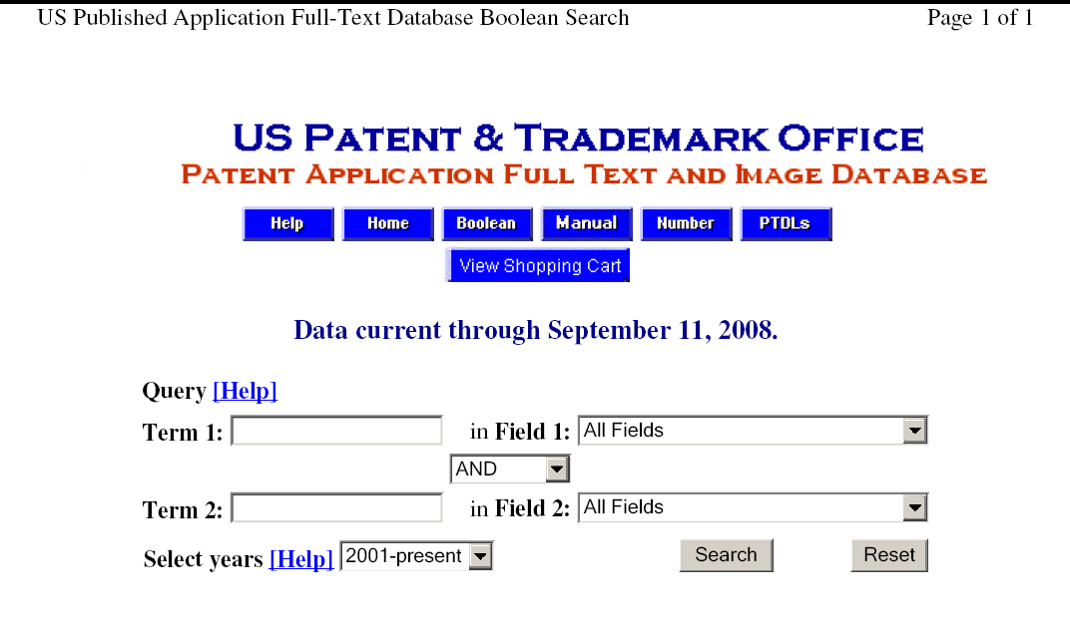
2) Tools and Searching Methods
1) Patent Offices (U.S. Patent Office)

Slide 28
2) Tools and Searching Methods
2) Third Party Searching Tools
Proprietary software or websites which allow searching of different country databases
Advantages
- Flexibility and natural language searching e.g. Google patents
- Good litmus test approach
- One source may be able to search multiple databases – one stop shop
Disadvantages
- Possibly additional $
- Reliant on the source databases
- Broad search results may not give you the answer

Slide 29
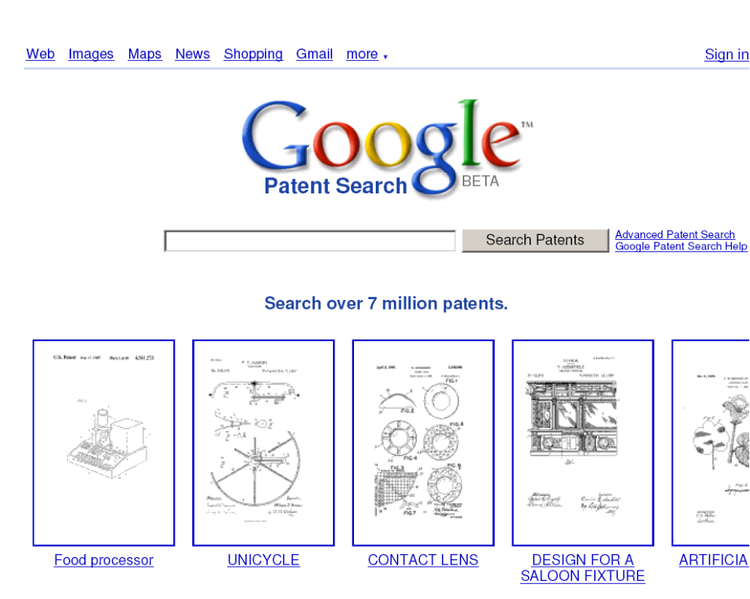
2) Tools and Searching Methods
2) Third Party Searching Tools (e.g. Google patents)

Slide 30
2) Tools and Searching Methods
3) Patent Download Websites
Provide full pdf versions of patents
Advantages
- Does not require page-by-page downloading
- Time-saving
- Should be used once searching is done to obtain patents
Disadvantages
- Poor search functionality – only accepts the patent number
- Additional logos added to documents

Slide 31
Outline
1) Introduction to patents
2) Tools and Searching Methods
3) Identifying the invention
4) Examples and exercise

Slide 32
3) Identifying the invention
Functional Analysis
Structural Analysis
Other Approaches

Slide 33
3) Identifying the invention
Functional Analysis vs. Structural Analysis
Functional Analysis
- Identifying features by their function rather than structure
- Requires broader thinking
- Allows you to understand the invention
- Better results down the road
Structural Analysis
- Identifying features by their structure rather than function
- Good litmus test - Easier to perform initially
- May not cover equivalents
- May miss important results

Slide 34
3) Identifying the invention
Step 1: Functional Analysis
- Make a chart
- List all the functions or actions that are happening in the invention
- Use “action” words (gerunds, i.e. words that end in “ing)
- Ask yourself what manipulative steps are occurring
e.g. - what is it doing?
- what are we doing to it?
- what is happening or going on?
- how/why is it working?
- what actions are need to make it work?
- what are the advantages of the invention
- Write down everything you can think of without considering its importance at this point
- Avoid the use of structural terms such as the names of components – a structural term is a physical item or thing, e.g. a member, a housing, a lever

Slide 35
3) Identifying the invention
Step 2: Compare functions with the prior art
- For each prior art reference, check off the functions that are and are not found in the references
- If you are not sure, put a question mark beside the function and come back to it later
- After comparing and eliminating, all that you should have remaining are the unique functional features of your invention.

Slide 36
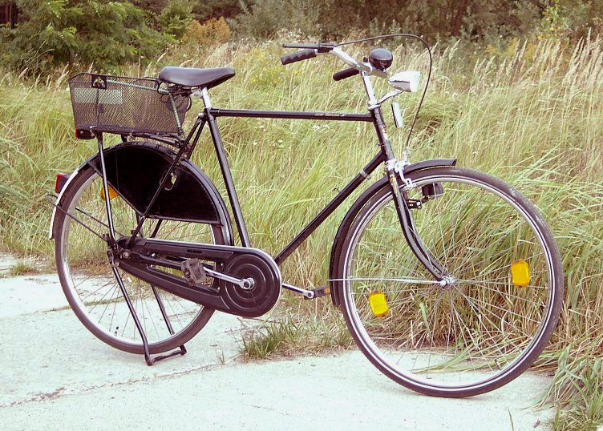
3) Identifying the invention
Function (e.g. a bicycle) | Prior art A
Rolling/Rotating
Pedaling
Leveraging (Mechanical advantage)
Steering

Slide 37
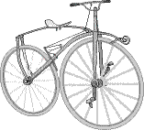
3) Identifying the invention
Function (e.g. a bicycle) | Prior art A
Rolling/Rotating | √
Pedaling | √
Leveraging (Mechanical advantage) | X
Steering | √

Slide 38
3) Identifying the invention
Function (e.g. a bicycle) | Prior art A
Rolling/Rotating | √
Pedaling | √
Leveraging (Mechanical advantage) | X
Steering | √

Slide 39
3) Identifying the invention
Other Approaches
- Search by competitor name
Keep tabs on what competitors are doing
Look for holes in their technology
Patent around their technology and “fence in” competitor
- Patent mining
Starting your research using a general field of search
Look for holes in the prior art
Don’t exactly know what you are inventing

Slide 40
Outline
1) Introduction to patents
2) Tools and Searching Methods
3) Identifying the invention
4) Infringement
5) Examples and exercise

Slide 41
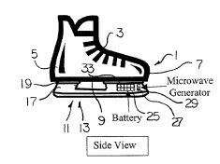
5) Examples and Exercise
You have invented:
Common ice skates used in skating have an elongate blade which is arranged to slide along the ice surface. Attempts to minimize the friction between the blade and the ice using heat, with limited success and cumbersome results.
You have designed an ice skate comprising a boot arranged to receive a person's foot, a skate blade assembly and a blade heating arrangement mounted within a blade mounting arrangement. The blade heating arrangement is arranged such that a transistor both controls the current and provides the thermal energy to heat skate blades using a processor and a power source.
A heating arrangement is arranged to use an electronic heating circuit to heat the skate blade such that the heat reduces the coefficient of friction of the blade on an ice surface.

Slide 42
5) Examples and Exercise
Additional features:
- An optional motion sensor arranged to control the heating of the blade such that when the skate is in use, the blade is heated and when the skate is not in use, the heat is off.
- The processor senses the temperature of the skate blade.
- Conveniently there are two distinct heating states controlled by the processor, no heating and full heating.

Slide 43
5) Examples and Exercise
You wish to know:
Prospects of patentability

Slide 44
5) Examples and Exercise
Function | Prior art A | Prior art B

Slide 45
5) Examples and Exercise
Function | Prior art A | Prior art B
Heating
Melting
Charging (battery)
Motion Sensing
Temperature sensing
Regulating
On/Off Switching
Others?

Slide 46
5) Examples and Exercise
Function | Structure
Heating | Current source
Melting
Charging (battery) | Charger
Motion Sensing | Motion sensor
Temperature sensing | Temperature sensor
Regulating | Microcontroller
On/Off Switching | Transistor
Others?

Slide 47
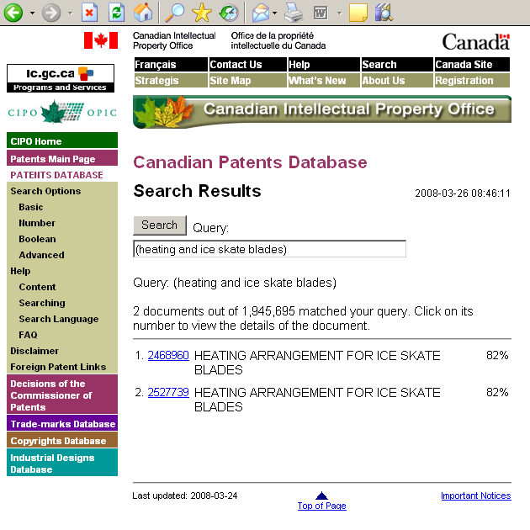
5) Examples and Exercise

Slide 48
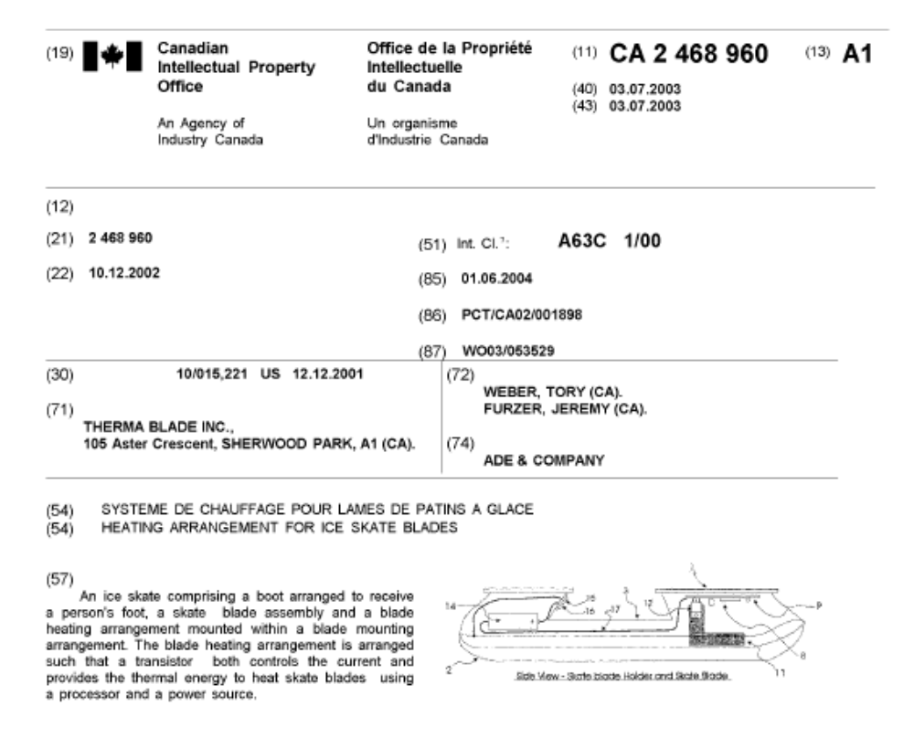
5) Examples and Exercise

Slide 49
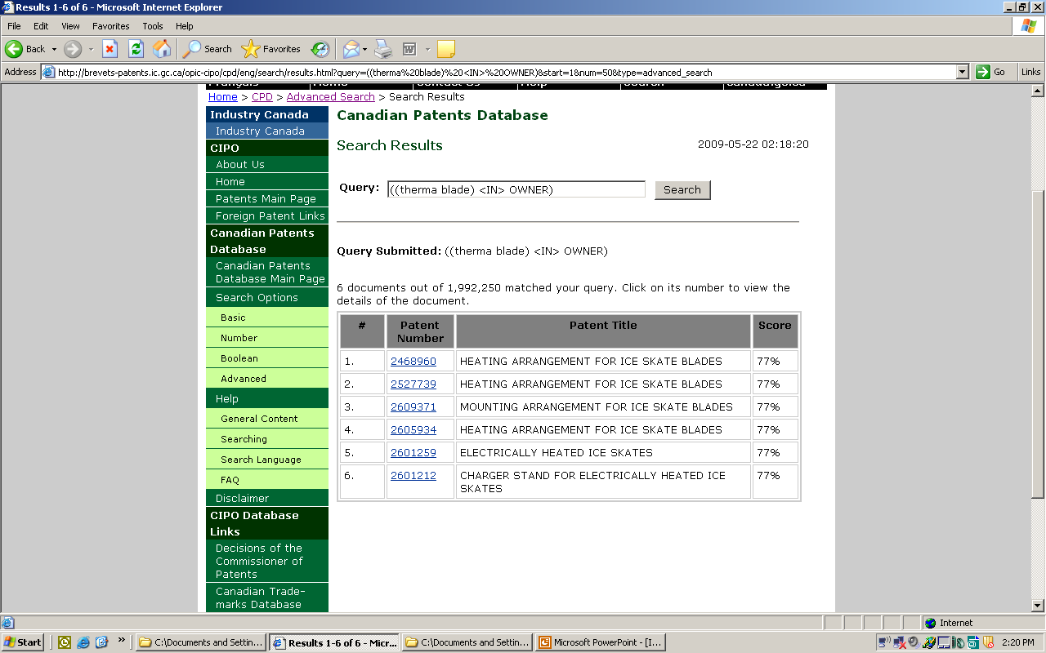
5) Examples and Exercise

Slide 50
5) Examples and Exercise
Function | Prior art A | Prior art B
Heating | √ | √
Melting | √ | √
Charging (battery) | √ | √
Motion Sensing | √ | √
Temperature sensing | √ | √
Regulating | √ | √
On/Off Switching | √ | √
Others? | √ | √

Slide 51
Concluding Remarks
Common Myths
Worldwide patents?
“Patent Pending”
Who owns the patent?
Patent rights are only exclusive rights

Slide 52
Concluding Remarks
How do I get a patent?
Invent something!
Identify that you invented something
Avoid prior public disclosure
Don’t assume that it’s not patentable or not valuable
Perform preliminary searching

Slide 53
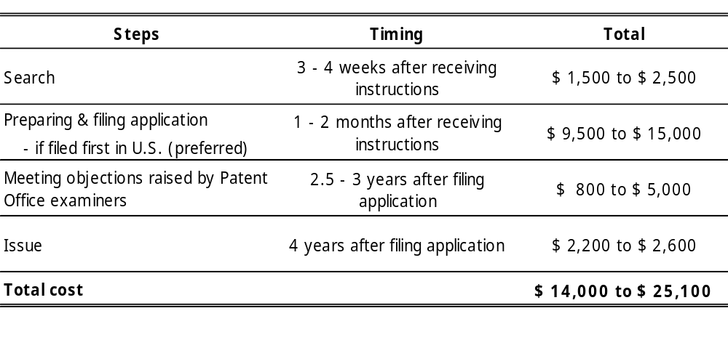
Concluding Remarks
How do I get a patent?
COST OF OBTAINING A PATENT IN UNITED STATES

Slide 54
Thank You
You may contact me at:
Benjamin Mak
Associate, Ridout & Maybee LLP
(416) 865-3502
bmak@ridoutmaybee.com

